Slide 1

Voice of the Customer
DYNAMICS 365

Slide 2

Mitch Milam
mitch@xrmcoaches.com
@mitchmilam
linkedin.com/in/mitchmilam
youtube.com/xRMCoaches

Slide 3
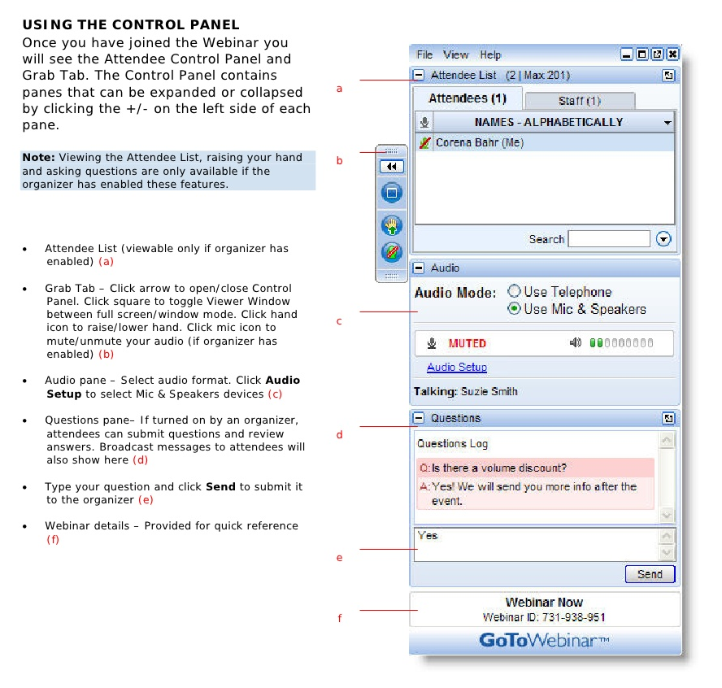
Webinar Housekeeping

Slide 4
Agenda
When
Where
Why
Technology
Tools

Slide 5

Announcements

Slide 6
Announcements
New Online Course Offerings
Dynamics 365 JavaScript Development
Dynamics 365 Plug-In Development
Dynamics 365 Maintenance and Troubleshooting
Go-Live on Monday, August 21st
Go-Live on Monday, August 28th
Go-Live on Monday, September 4th

Slide 7
Introduction

Slide 8
What is VOC
An integrated survey tool
Respondents can take your surveys on a phone, tablet, or computer
Can use rules to trigger follow-up actions
Survey analytics included

Slide 9
Where is VOC
VOC mostly exists inside of Azure assets
VOC is configured and managed inside of Dynamics 365
Respondent data is automatically synced back to Dynamics 365

Slide 10
Limitations
Maximum # of surveys you can publish: 200
Maximum # of questions on a survey: 250
If you've enabled feedback for a survey, you can include a maximum of 40 questions.
Maximum # of pages per survey: 25
Maximum # of survey responses that Voice of the Customer will store: 1,000,000

Slide 11
Limitations
Maximum # of email invitations that you can send that include piped data in a 24-hour period: 10,000.
Any emails that exceed that amount will remain pending during that time and will automatically start sending when the time limit is over.
Maximum # of survey responses you can pull per day: 2400

Slide 12
Terminology
NPS is Net Promoter Score
Face is Smiley Face

Slide 13
Installation and Setup

Slide 14
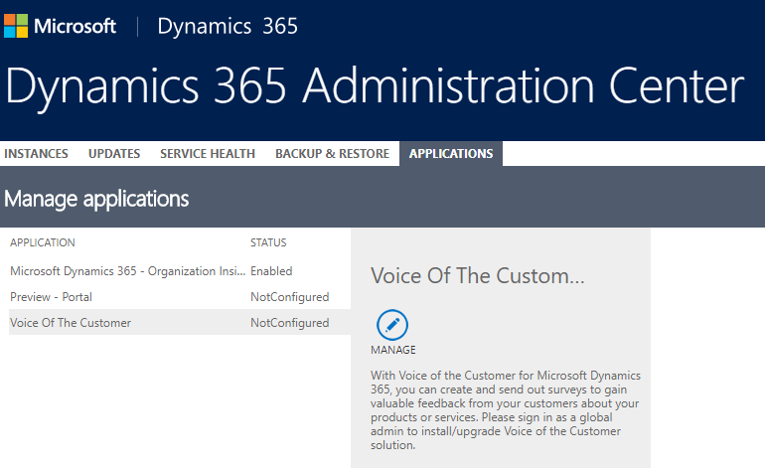
Step 1

Slide 15
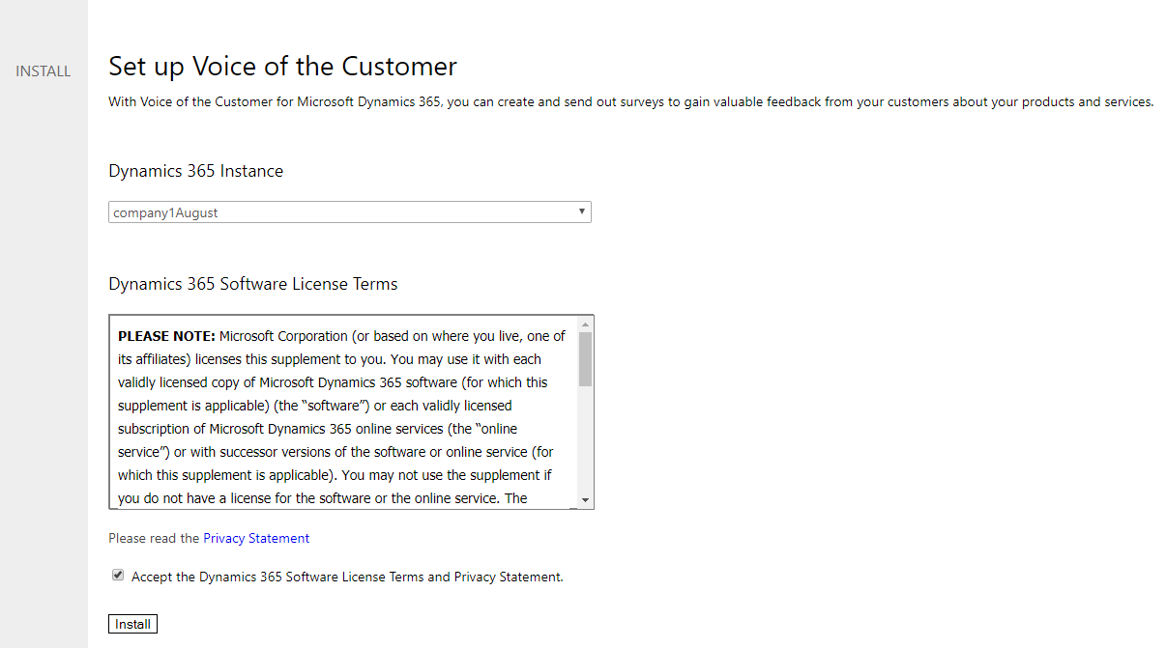
Step 2

Slide 16
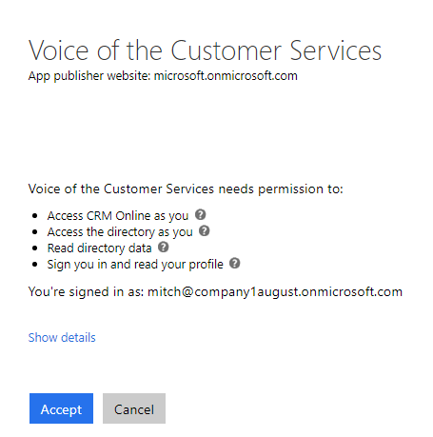
Step 3

Slide 17
Configuration
Settings, Voice of the Customer Configuration

Slide 18
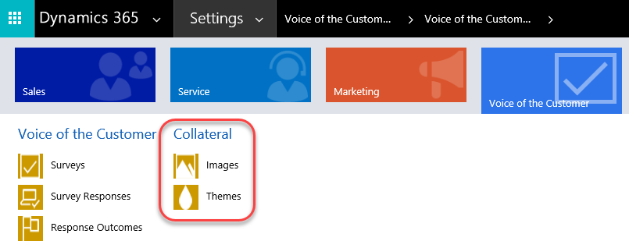
Collateral Configuration

Slide 19
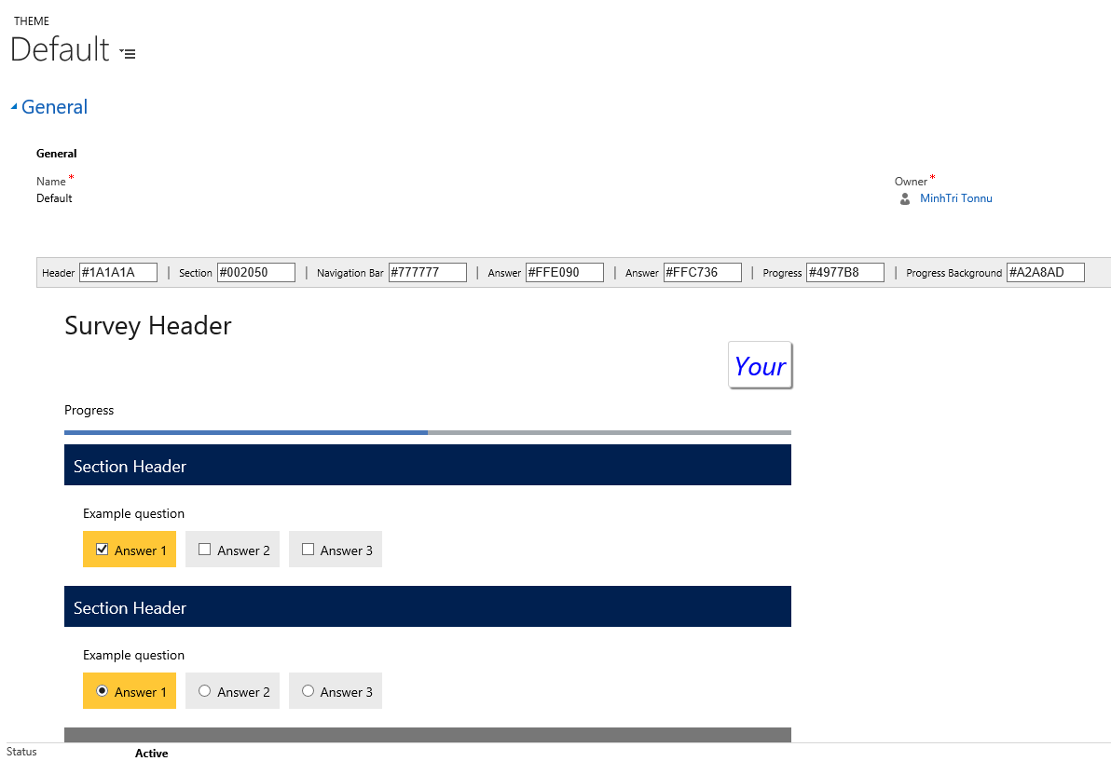
Themes

Slide 20
Customization Points
Email Face Template
Email NPS Template
Email Rating Template
Feedback Charts
Feedback Dashboards
Feedback Form - Actions Tab
Feedback Form - Empty Response Section

Slide 21
Using VOC

Slide 22
VOC Flow
Plan
Design
Personalize
Create Response Routing Rules
Distribute the Survey
Analytics

Slide 23
Planning
Less than 5 minutes
Less than 10 questions
What questions are required
Distribution method (email vs web)

Slide 24
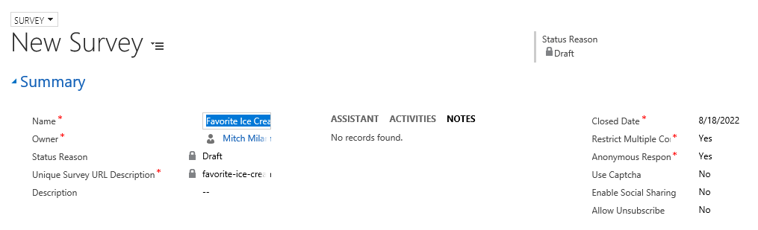
Design: Data

Slide 25
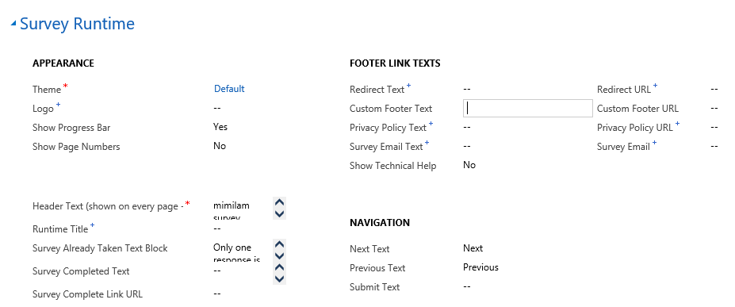
Design: Data

Slide 26
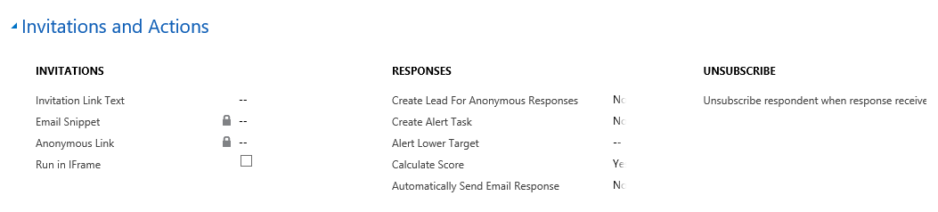
Design: Data

Slide 27
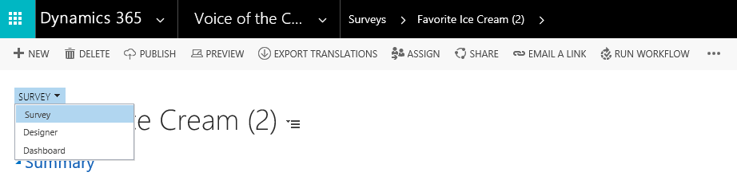
Survey Designer

Slide 28
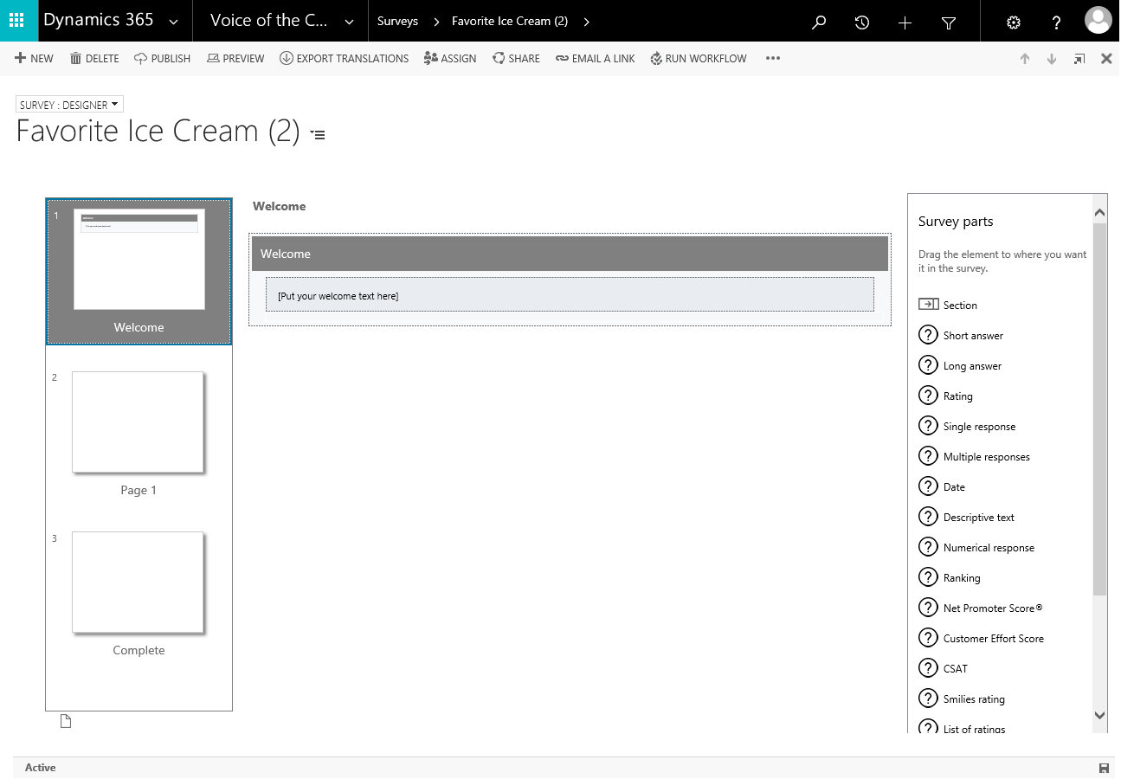
Survey Designer

Slide 29
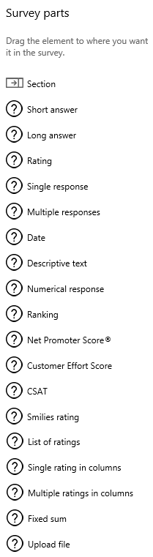
Survey Parts

Slide 30
Personalize
You may add data from:
User
Product
Service
Customer
Location
Date/Time
Other

Slide 31
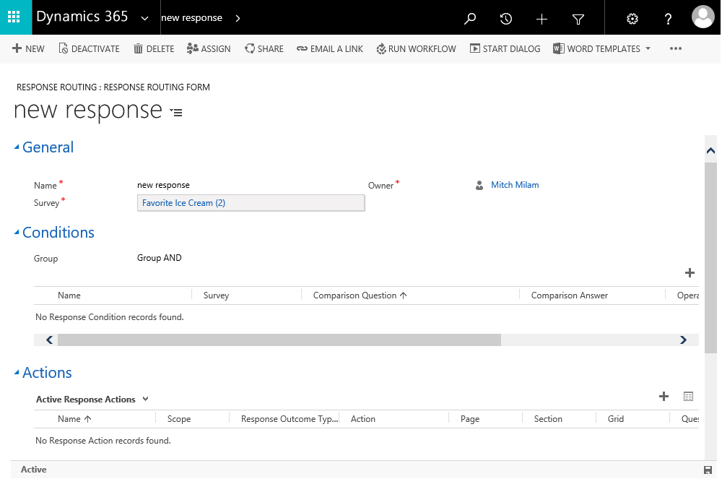
Response Routing Rules

Slide 32
Distribution
Survey Types
Anonymous
Non-Anonymous
Media
Email
Web
Other
Piped Data
[Survey-Snippet-Start]ce4d36ac-1584-e711-8137-e0071b72a7d1|customer=Bob[Survey-Snippet-End]

Slide 33
Analytics
Dashboards
Reports

Slide 34
Questions?

Slide 35
Thank You

